Slide 1

Semester Project: Complete overview
Subtitle
Notes:
To change the image on this slide, select the picture and delete it. Then click the Pictures icon in the placeholder to insert your own image.

Slide 2
Context
Who: AVP, Quality Assurance at MetLife.
Department: Global Technology & Operations – Customer Service and Operations Branch.
Responsibilities:
Optimize and simplify Quality Assurance through re-engineered processes.
Leverage technology and automation for operational efficiency.
Provide strategic consultation to internal and external customers.
Challenge: Recently joining MetLife, the AVP aims to optimize claims processing, reduce costs, and enhance customer satisfaction while driving strategic business improvements.

Slide 3
Dataset Overview
Data Sources:
Insurance Data: Includes insurance type, claim amount, premium, incident details, and insurer information.
Employee Data: Includes Agent ID, tenure, and join date.
Dataset Size:
Total records: 12,000+
Columns: 25 columns from both datasets combined
Key Features:
Insurance Type: life, health, property, mobile, motor
Claim Amount: Ranges from minor to major loss incidents.
Challenges:
Missing data in key fields like City, Customer Education Level, and Incident Severity.
Data Cleaning Solutions:
Filled missing values with "Unknown" for consistency.
Removed irrelevant columns like Address Line 2.

Slide 4
Objective and Value
Objective:
To optimize MetLife's claims processing, improve product profitability, and refine workforce strategies using data-driven insights.
Value to Client :
Claims Processing Efficiency: Decision Tree model improves claim approval speed and reduces operational costs by automating predictions.
Product Profitability: Identified life insurance as a high-risk, high-reward product, enabling better pricing strategies.

Slide 5
Predictive Modeling
Model Chosen:
Decision Tree for classification, leveraging its ability to handle non-linear relationships and complex data patterns.
Results:
Training Accuracy: 95%, Testing Accuracy: 85%—high generalizability.
High Recall (88.05%): Ensures most approved claims are identified, speeding up processing and reducing operational delays.
High Precision (95.4%): Minimizes false positives, enhancing accuracy in claim predictions and reducing manual reviews.
Challenges:
Moderate ROC AUC (0.452) indicates room for improvement in handling denied claims, suggesting the need for more advanced model refinement.

Slide 6
Metrics Comparison
Decision Tree
Logistic Regression
Training Score: 0.95
Testing Score: 0.85
ROC AUC = 0.452
Recall: 88.05%
Precision: 95.4%
Training Score: 0.56
Testing Score: 0.51
ROC AUC = 0.452
Recall: 51.36%
Precision: 94.59%

Slide 7
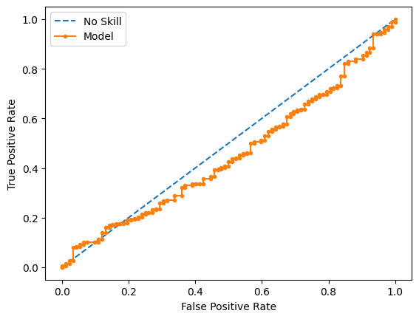
ROC Curve for Decision Tree Model
ROC AUC: 0.452
Model struggles to differentiate between approved and denied claim

Slide 8
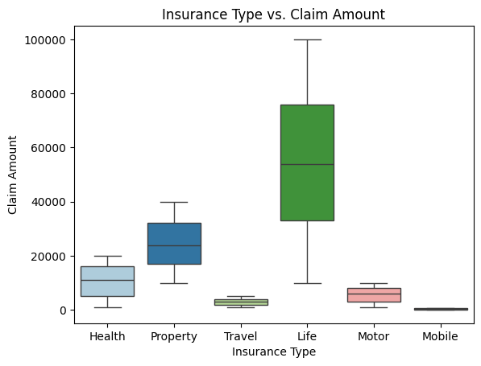
Insurance Type vs Claim Amount
Life insurance has the highest median and max claim amount also the highest variance among all insurance groups
Life insurance is riskier and more costly than other types

Slide 9
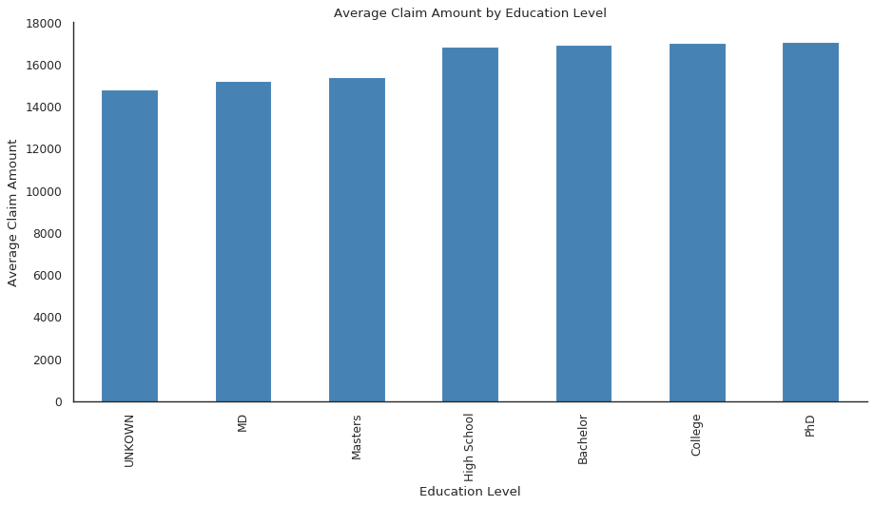
Average Claim Amount by Education Level
The average claim amount is higher generally for High School, Bachelor, College, and PhD graduates
This may indicate they file larger claim amount and are riskier

Slide 10
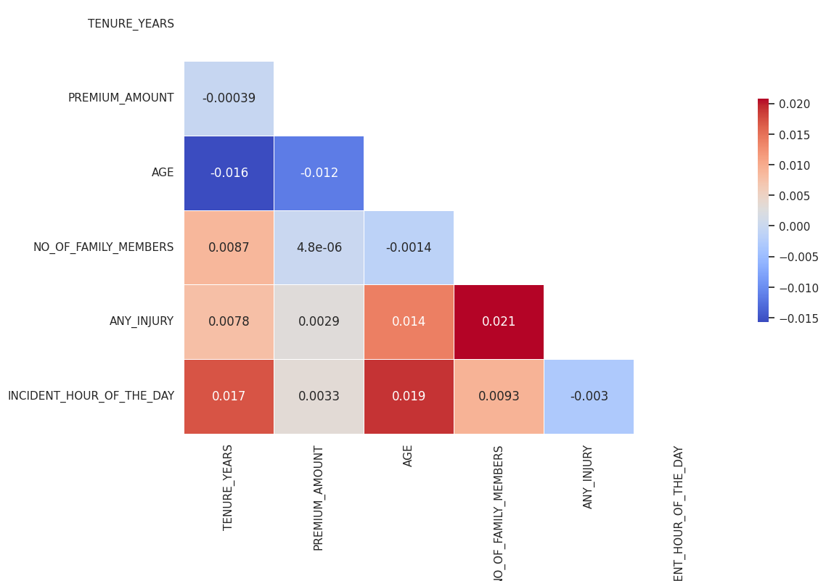
Correlation Heatmap of Quantitative Data
Most variables show no linear correlation.
Suggests potential for non-linear relationships worth further exploration.

Slide 11
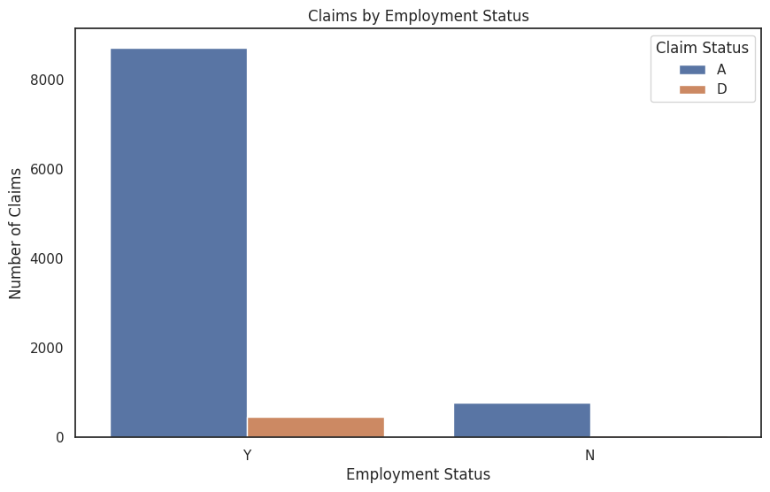
Claim Amount by Employment Status
Significant claim mismatch for unemployed customers.
Opportunity to develop insurance products tailored to this segment.
Insights for product diversification and market growth.

Slide 12
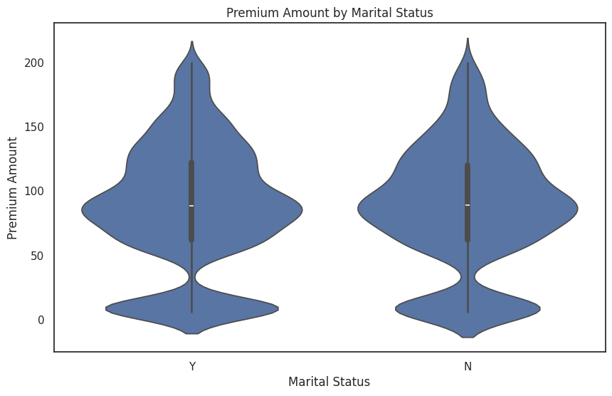
Premium Amount by Marital Status
Plot shows almost no difference in premium paid by marital status
Suggest marital status is not a risk factor
Indicate other factors are more important

Slide 13
Insights Summary
Life insurance is the riskiest and costliest
Customers with high school, bachelor, college, and PhD degrees has highest average claim amount = riskier
Agent tenure is uniform(indicate good workforce planning),
No correlation between quantitative data meaning a potential non-linear relationship
Similar premium paid by marital status indicate it is a non risk factor
Mismatch in claim amount by employment status shows a need for insurance product targeting unemployed

Slide 14
Recommendations
For Products:
Prioritize life insurance while refining premiums for riskier demographics (e.g., higher education groups).
Develop targeted products for unemployed customers based on claim discrepancies.
For Operations:
Leverage the Decision Tree model to automate claim approvals.
Monitor prediction to improve denied claim accuracy.
Continue to collect data to increase data size for better modeling
For Workforce:
Maintain balanced hiring and retention practices based on uniform tenure distribution.

